Slide 1

MLB Batters performance against same-handed pitchers
Data analysis report
by Sooji Rhodes
October 17th, 2021

Slide 2
Same-handed vs. opposite-handed
Problem statement:
“Is there a significant advantage for the batters when the pitcher and the batter are opposite-handed?”
Notes:
In baseball, "switch hitters" switch their bat stance with the opposite hand from the pitcher. For example, When the Brave's second baseman Ozzie Albies faces a lefty pitcher, he bats righty. Switch hitters are deemed valuable for their ability to face any pitcher. Nevertheless, is there a significant advantage for the batters when the pitcher and the batter are opposite-handed? Could it be another "old-school tradition" that baseball players follow? This research will help deep dive into the batters' performance based on the pitcher's handedness. This research will benefit casual baseball fans and sports analysts alike. Because we are using actual data from the 2021 season, and both audiences will find the data relevant and useful.

Slide 3
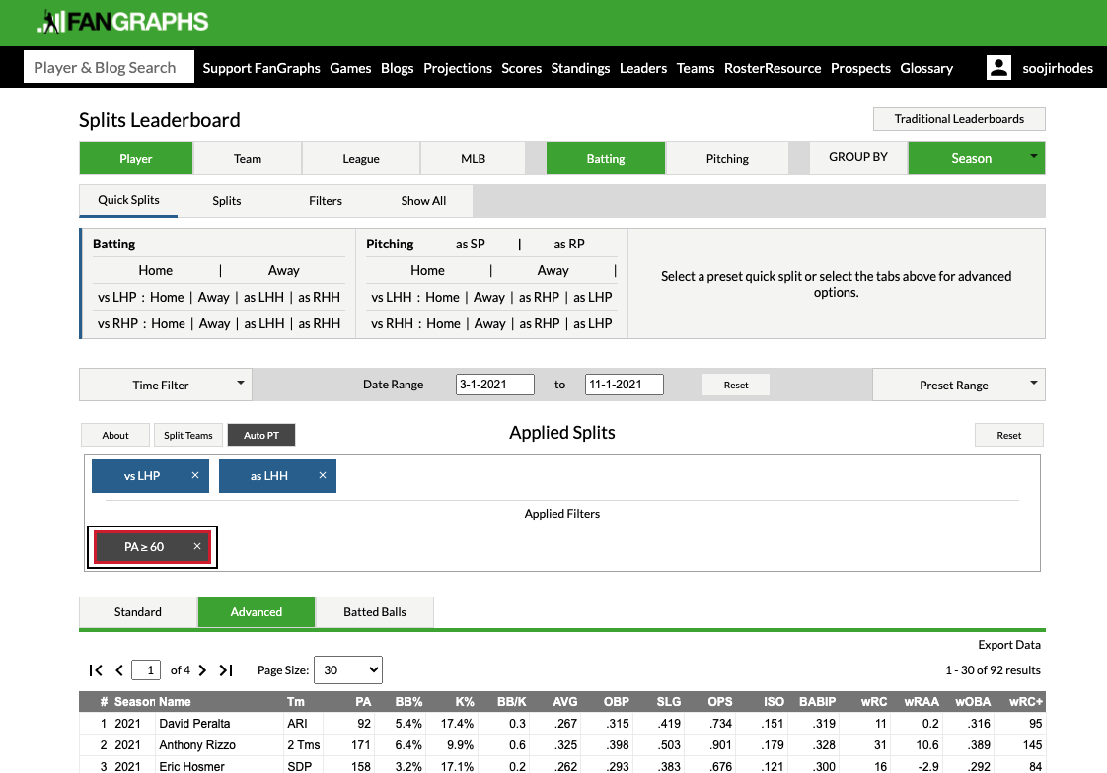
Data
MLB players in 2021 with < 60 plate appearance
OPS as the only performance measure
Group 1 (304 observations):
lefty pitcher + lefty batter
Righty pitcher + righty batter
Group 2 (506 observations):
Lefty pitcher + righty batter
Righty pitcher + lefty batter
Notes:
The data we will be using is from [FanGraphs.com](https://www.fangraphs.com). FanGraphs has a great filter system for end-users to download quickly, including Splits Leaderboard. There are four .csv files:
* [left-handed pitcher vs. left-handed hitter](https://www.fangraphs.com/leaders/splits-leaderboards?splitArr=1,3&splitArrPitch=&position=B&autoPt=true&splitTeams=false&statType=player&statgroup=2&startDate=2021-03-01&endDate=2021-11-01&players=&filter=&groupBy=season&sort=-1,1)
* [left-handed pitcher vs. right-handed hitter](https://www.fangraphs.com/leaders/splits-leaderboards?splitArr=1,4&splitArrPitch=&position=B&autoPt=true&splitTeams=false&statType=player&statgroup=2&startDate=2021-03-01&endDate=2021-11-01&players=&filter=&groupBy=season&sort=-1,1)
* [right-handed pitcher vs. left-handed hitter](https://www.fangraphs.com/leaders/splits-leaderboards?splitArr=2,3&splitArrPitch=&position=B&autoPt=true&splitTeams=false&statType=player&statgroup=2&startDate=2021-03-01&endDate=2021-11-01&players=&filter=&groupBy=season&sort=-1,1)
* [right-handed pitcher vs. right-handed hitter](https://www.fangraphs.com/leaders/splits-leaderboards?splitArr=2,4&splitArrPitch=&position=B&autoPt=true&splitTeams=false&statType=player&statgroup=2&startDate=2021-03-01&endDate=2021-11-01&players=&filter=&groupBy=season&sort=-1,1)
There are a few facts and assumptions that we will be making while utilizing the dataset.
1. We will only look at players who are in the Major League Baseball (MLB) system.
1. We will only look at players who played during the 2021 season.
1. To ensure all on-base plus slugging (OPS) is fair and statistically accurate, we will only look at players with a plate appearance of a minimum of 60.
1. For the simplicity of the research, we will sort the data into two groups, same handedness between pitcher and batter and opposite handedness between pitcher and batter. For instance, the first group will be both a lefty pitcher and a lefty batter combination and a righty pitcher and a righty batter combination. The second group will be a lefty pitcher and a righty batter combination and a righty pitcher and a lefty batter combination.
1. We will only look at OPS as the batter's performance measure.
The data contains 810 non-null observations and 20 variables. There are no missing values.

Slide 4
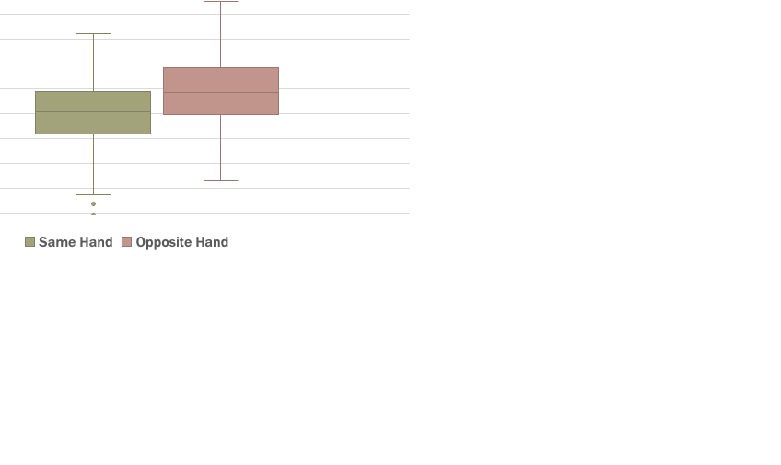
result
With 95% confidence, the average OPS is between 0.067 and 0.105 higher when faced an opposite-handed pitcher.
Notes:
Both groups' OPS are normally distributed based on a visual inspection, so I proceeded with the t-test. Skewness and kurtosis are also within -3 and 3, which further validates my decision.
Based on a p-value < 0.05, I reject the null hypothesis. There is a significant difference between the two groups' performance.
The 95% confidence interval suggests that the difference between the same-handed and opposite-handed groups is between 0.067 and 0.105, which can be interpreted as a significant difference in OPS. For instance, the average OPS for opposite-handed batters is 0.788, and the average OPS for same-handed batters is 0.702. The difference in these two numbers is significant enough for general managers to decide between two batters.

Slide 5

Next step
Batting order
Roster construction
Notes:
Now that we know the handedness matters for a batter, our subsequent research can be about a team's lineup. Because a pitcher must face at least two batters when he comes on the mound, a team can get a great result alternating lefty batters and righty batters. This makes for informative and inexpensive research that MLB can adopt.

Slide 6
Thank you!
Reference
https://www.fangraphs.com
https://unsplash.com

